Slide 1
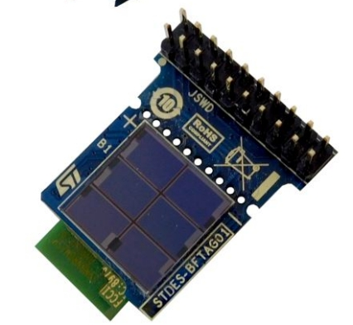
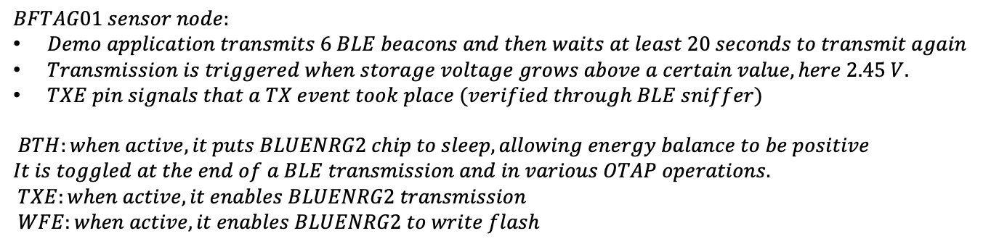
BFTAG01 – AUTONOMOUS BLE SENSOR NODE
$BFTAG01 sensor node:$
$Demo application transmits 6 BLE beacons and then waits at least 20 seconds to transmit again$
$Transmission is triggered when storage voltage grows above a certain value, here 2.45 V.$
$TXE pin signals that a TX event took place (verified through BLE sniffer)$
$BTH:when active, it puts BLUENRG2 chip to sleep, allowing energy balance to be positive$
$$It is toggled at the end of a BLE transmission and in various OTAP operations.$$
$TXE:when active, it enables BLUENRG2 transmission$
$WFE:when active, it enables BLUENRG2 to write flash$

Slide 2

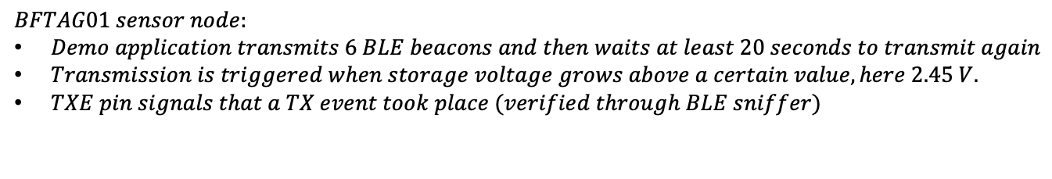
BFTAG01 – AUTONOMOUS BLE SENSOR NODE
$$TX enabled$$
$$Finished TX:aci_end_of_radio_activity_event()$$
$BFTAG01 sensor node:$
$Demo application transmits 6 BLE beacons and then waits at least 20 seconds to transmit again$
$Transmission is triggered when storage voltage grows above a certain value, here 2.45 V.$
$TXE pin signals that a TX event took place (verified through BLE sniffer)$

Slide 3
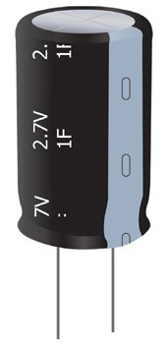

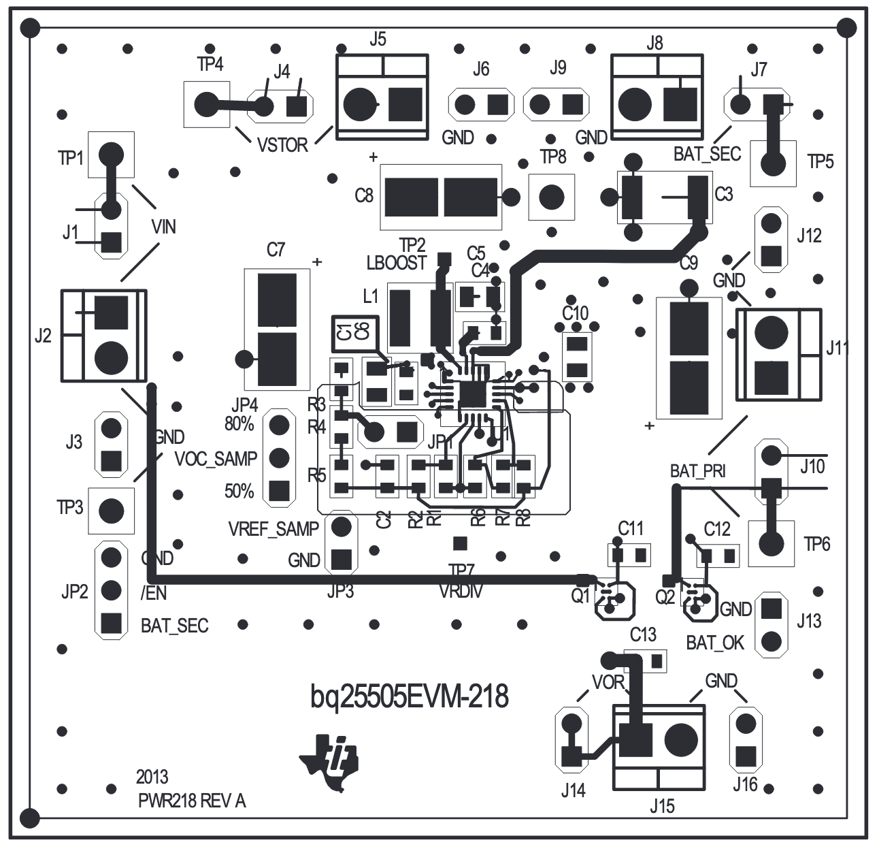


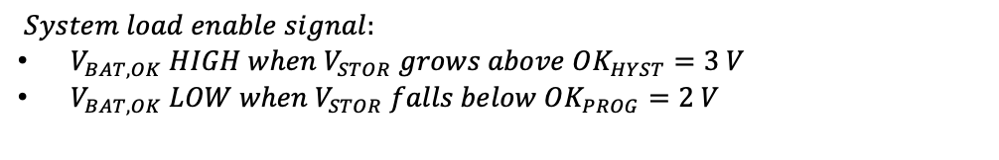


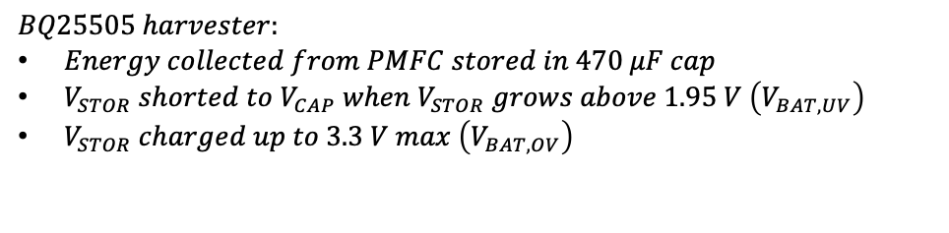




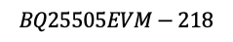

BFTAG01: PMFC BLE SENSOR NODE
$$V_{BAT,OK}$$
$$V_{DD,TAG}$$
$$V_{STOR}$$
$$\text{MIC}\text{94071}$$
$$470 μF$$
$$V_{BAT,OK}$$
$$BFTAG01$$
$$BQ25505EVM−218$$
$$Covered PV$$
$BQ25505 harvester:$
$Energy collected from PMFC stored in 470 μF cap$
$V_{STOR} shorted to V_{CAP} when V_{STOR} grows above 1.95 V \left(V_{BAT,UV}\right)$
$V_{STOR} charged up to 3.3 V max \left(V_{BAT,OV}\right)$
$System load enable signal:$
$V_{BAT,OK} HIGH when V_{STOR} grows above OK_{HYST}=3 V$
$V_{BAT,OK} LOW when V_{STOR} falls below OK_{PROG}=2 V$
$BFTAG enables BLE transmission when V_{DD,TAG} grows above 3.1 V$

Slide 4
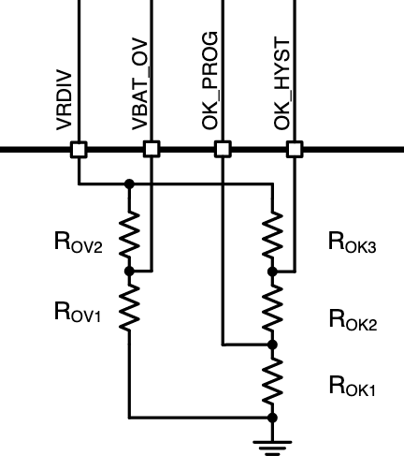
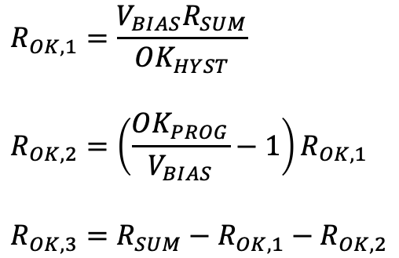
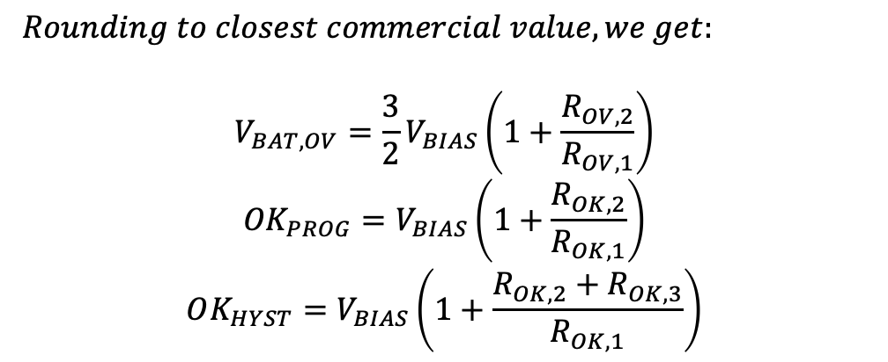
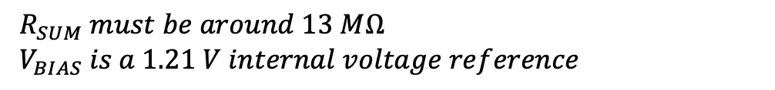
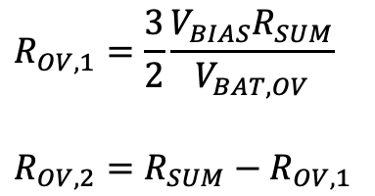
BQ25505: set thresholds with resistors
$R_{SUM} must be around 13 MΩ$
$V_{BIAS} is a 1.21 V internal voltage reference$
$$R_{OK,1}=\frac{V_{BIAS}R_{SUM}}{OK_{HYST}}$$
$$R_{OK,2}=\left(\frac{OK_{PROG}}{V_{BIAS}}−1\right)R_{OK,1}$$
$$R_{OK,3}=R_{SUM}−R_{OK,1}−R_{OK,2}$$
$$R_{OV,1}=\frac{3}{2}\frac{V_{BIAS}R_{SUM}}{V_{BAT,OV}}$$
$$R_{OV,2}=R_{SUM}−R_{OV,1}$$
$Rounding to closest commercial value, we get:$
$$V_{BAT,OV}=\frac{3}{2}V_{BIAS}\left(1+\frac{R_{OV,2}}{R_{OV,1}}\right)$$
$${OK}_{PROG}=V_{BIAS}\left(1+\frac{R_{OK,2}}{R_{OK,1}}\right)$$
$$OK_{HYST}=V_{BIAS}\left(1+\frac{R_{OK,2}+R_{OK,3}}{R_{OK,1}}\right)$$

Slide 5
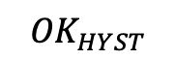
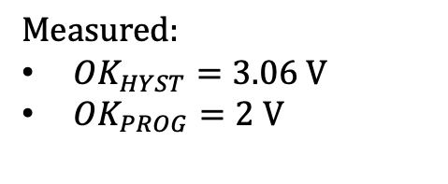
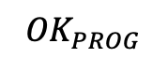
BQ25505: verify thresholds
$${OK}_{HYST}$$
$${OK}_{PROG}$$
$$Measured:$$
${OK}_{HYST}=3.06 V$
${OK}_{PROG}=2 V$

Slide 6

INITIAL TEST: NO LOAD SWITCH
$Load is attached during cold start$
$Plant wasn^{′}t able to replicate test after the first time$
$Solar panel was not covered so it might have helped$
$A younger plant might make this work but using a load switch is better$

Slide 7
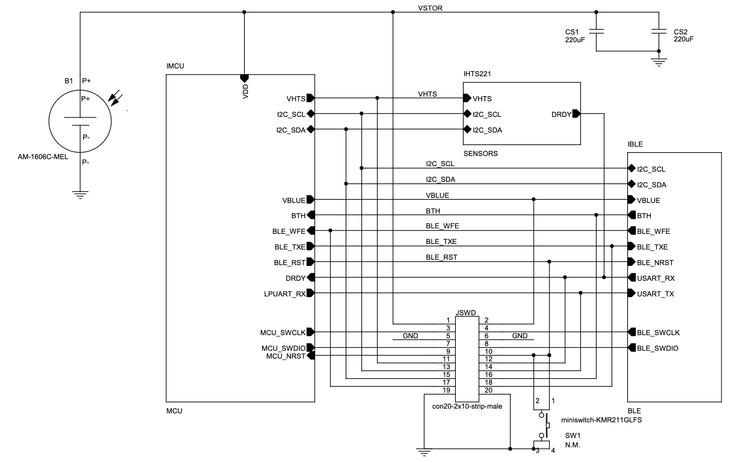
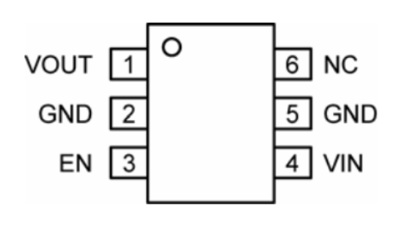

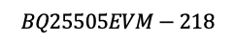









PREVIOUS SETUP: PMFC BLE SENSOR NODE
$$V_{BAT,OK}$$
$$470 μF$$
$$V_{BAT,OK}$$
$$Covered PV$$
$$BQ25505EVM−218$$
$$\text{MIC}\text{94071 }\text{switch}\text{ − }\text{connections}$$
$$V_{DD,TAG}$$
$$V_{BAT,OK}$$
$$V_{STOR}$$
$$\text{S}\text{witch} \text{is} \text{closed} \text{when} \text{EN} \text{is} \text{high}$$
$$BFTAG01$$

Slide 8
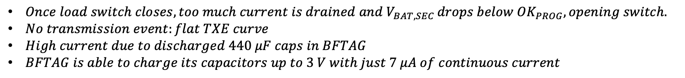
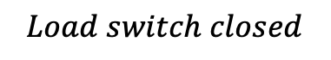
TEST: LOAD SWITCH
$$Load switch closed$$
$Once load switch closes, too much current is drained and V_{BAT,SEC }drops below OK_{PROG}, opening switch.$
$No transmission event:flat TXE curve$
$High current due to discharged 440 μF caps in BFTAG$
$BFTAG is able to charge its capacitors up to 3 V with just 7 μA of continuous current$

Slide 9
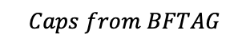
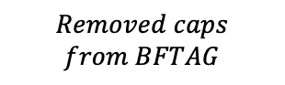
CURRENT SETUP: PMFC BLE SENSOR NODE
$$Caps from BFTAG$$
$$V_{BAT,OK}$$
$$Removed caps$$
$$from BFTAG$$
$$470 μF$$
$$V_{BAT,OK}$$
$$Covered PV$$
$$BQ25505EVM−218$$
$$\text{MIC}\text{94071 }\text{switch}\text{ − }\text{connections}$$
$$V_{DD,TAG}$$
$$V_{BAT,OK}$$
$$V_{STOR}$$
$$\text{S}\text{witch} \text{is} \text{closed} \text{when} \text{EN} \text{is} \text{high}$$
$$BFTAG01$$

Slide 10
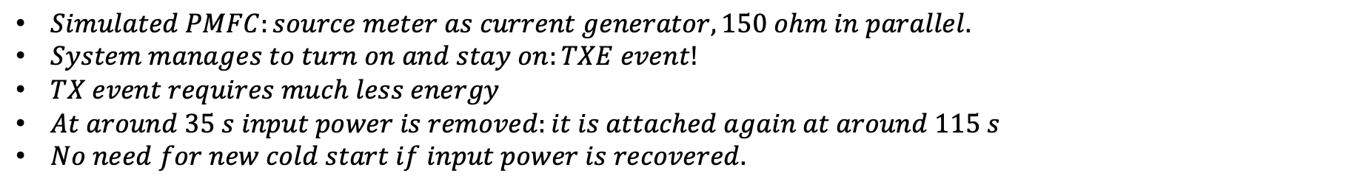
TEST: LOAD SWITCH, MOVED CAPS, SIMULATED PLANT
$$Load switch closed$$
$Simulated PMFC:source meter as current generator, 150 ohm in parallel.$
$System manages to turn on and stay on:TXE event!$
$TX event requires much less energy$
$At around 35 s input power is removed:it is attached again at around 115 s$
$No need for new cold start if input power is recovered.$

Slide 11

TEST: LOAD SWITCH, MOVED CAPS, REAL PLANT
$PMFC manages to supply enough energy for multiple transmissions.$
$Beacons gradually space out due to sampled MPP straying from actual MPP.$
$Plant could also tire out, influence of MPPT algorithm and PMFC stress is to be studied.$
$At around 11 mins I removed V_{bat_{ok}} to detach load from BQ and check how plant OCV recovers.$
$OCV recovers to the pre−test value in around 10 minutes.$

Slide 12
GOALS
$System should overcome cold start only once:ensured by OK_{PROG}>V_{COLD}≈1.5 V$
$Energy provided inbetween OK_{HYST} and OK_{PROG} needs to be enough to activate, sense and tx a BLE beacon$
$This energy was around 1.2 mJ before caps were moved, now it is$
TO DO
$Computed energy doesn^{′}t include startup energy required to activate BFTAG:check that 470 μF is enough$
$Decrease BFTAG startup energy by removing the two 220 μF caps in parallel in BFTAG$

